Slide 1

Acoustic characterization of absorbing materials using dynamic mode decomposition techniques
Gonzalo Carazo Barbero
Notes:
(00:00 – 00:30)
Name
Title: Caracterización Acustica de materiales absorbentes utilizando la descomposicion modal dinamica (DMD)
http://www.tlhiv.org/ltxpreview/

Slide 2



Companies Involved
ITMATI (Thechnological Institute for Industrial Mathematics)
Microflown Technologies
ROMSOC Project (Reduced Order Modeling, Simulation and Optimization of Coupled Systems)
Notes:
(00:30 – 01:00)
ITMATI: Instituto tecnológico de matemática industrial
Surge … colaboración … univ. publicas gallegas:
- University of A Coruña (UDC)
- University of Santiago de Compostela (USC)
- University of Vigo (UVigo)
Microflown: Paises bajos
1998 University of Twente
Por Hans-Elias de Bree
??
ROMSOC: Proyecto Europeo
Modelado, simulacion y optimizacion de sistemas acoplados con a traves de metodos de orden reducido
Reduced Order Modeling, Simulation and Optimization of Coupled Systems

Slide 3

Introduction
Phases of the project:
Numerical simulation
Validating the models
Applying DMD
Ashwin Nayak’s PhD Thesis:
3D unbounded coupled model in the frequency domain
Simplified Problem:
1D acoustic coupled model in the time domain
Notes:
(01:00 – 01:30)
Relacionado tesis doctoral Ashwin Nayak
Modelo acoplado tridimensional en frecuencia
Acopla flujo de fluidos, Acustica y otros
3 Fases: Simulación numérica
Validación
Aplicacion de DMD

Slide 4
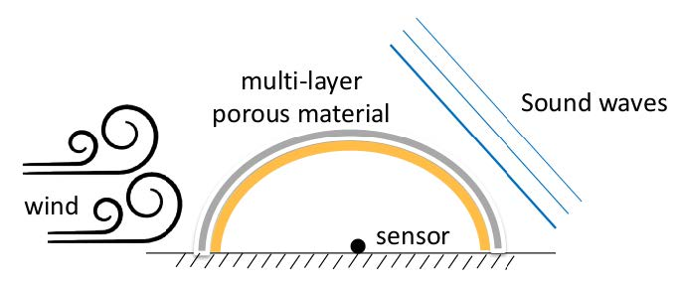
Introduction
Phases of the project:
Numerical simulation
Validating the models
Applying DMD
Ashwin Nayak’s PhD Thesis:
3D unbounded coupled model in the frequency domain
Simplified Problem:
1D acoustic coupled model in the time domain
Notes:
(01:30 – 02:00)
Relacionado tesis doctoral Ashwin Nayak
Modelo acoplado tridimensional en frecuencia
Acopla flujo de fluidos, Acustica y otros
3 Fases: Simulación numérica
Validación
Aplicacion de DMD

Slide 5
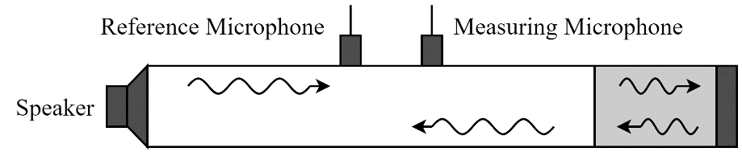
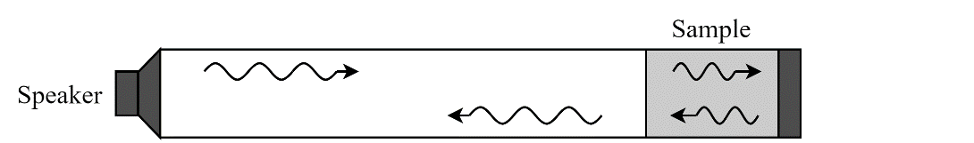
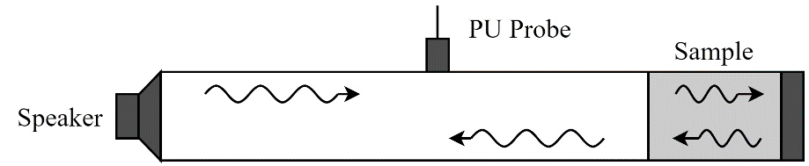
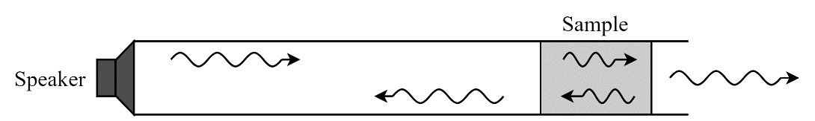
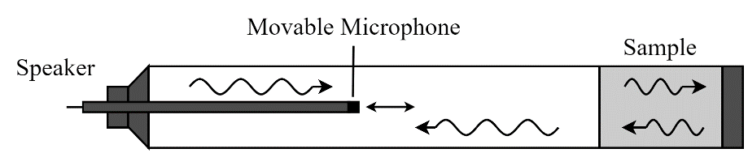
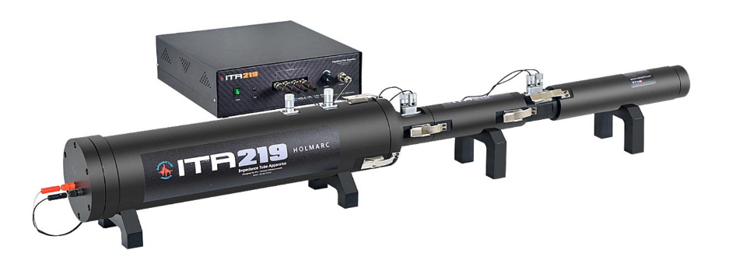
Motivation of the Physical Setting
Experimental Settings
Simulated settings
Holmarc Opto-Mechatronics Impedance tube*
* Holmarc Opto-Mechatronics Pvt. Ltd.: Impedance Tube Apparatus. https://holmarc.com/impedance_tube_apparatus_a.php
Notes:
(02:00 – 02:30)
Objetivo Simular un tubo de Kundt
Sin sensores
2 configuraciones fisicas: frontera rigida y transparente

Slide 6
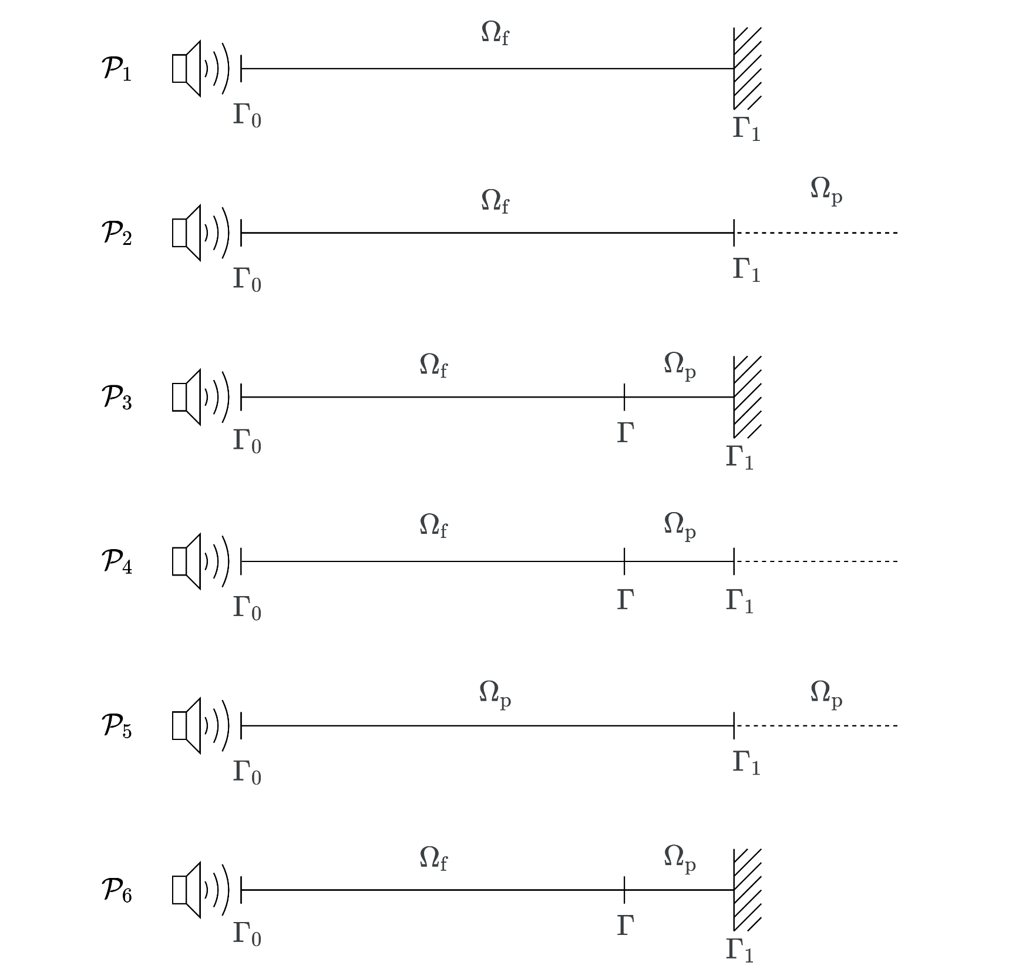
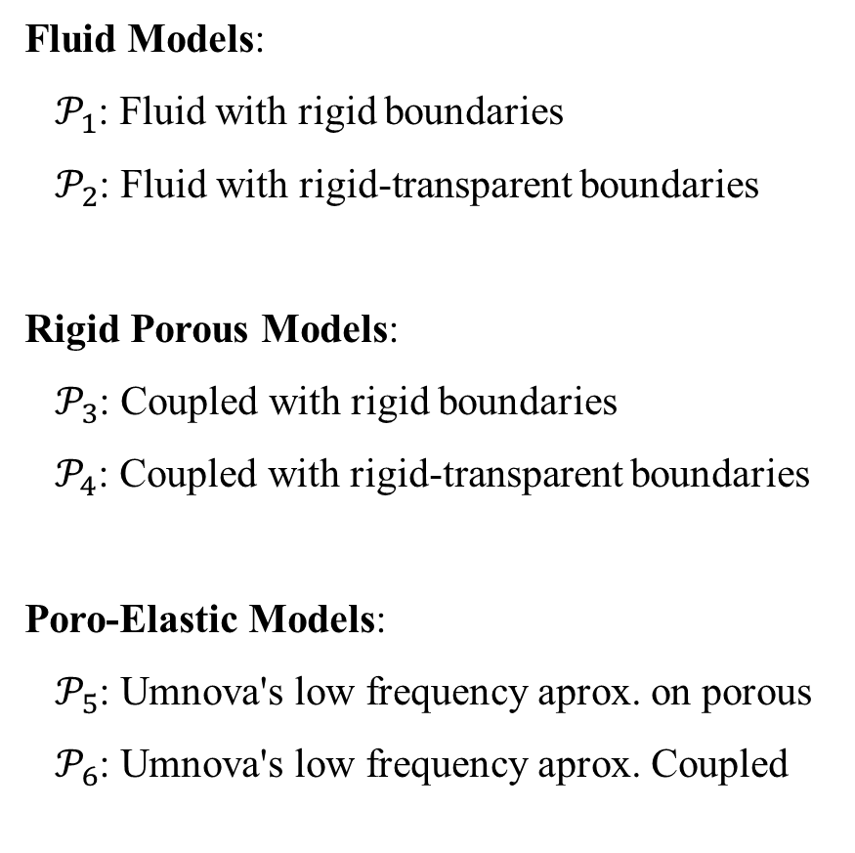
Used Models
Fluid Models:
$𝒫_{1}$: Fluid with rigid boundaries
$𝒫_{2}$: Fluid with rigid-transparent boundaries
Rigid Porous Models:
$𝒫_{3}$: Coupled with rigid boundaries
$𝒫_{4}$: Coupled with rigid-transparent boundaries
Poro-Elastic Models:
$𝒫_{5}$: Umnova's low frequency aprox. on porous
$𝒫_{6}$: Umnova's low frequency aprox. Coupled
Notes:
(02:30 – 03:00)
2 Fluidos (frontera cerrada/abierta)
2 Porosos rigidos acoplados (frontera cerrada/abierta)
2 Poro-elasticos (uno de ellos acoplado)

Slide 7
Used Models
Fluid Models:
$𝒫_{1}$: Fluid with rigid boundaries
$𝒫_{2}$: Fluid with rigid-transparent boundaries
Rigid Porous Models:
$𝒫_{3}$: Coupled with rigid boundaries
$𝒫_{4}$: Coupled with rigid-transparent boundaries
Poro-Elastic Models:
$𝒫_{5}$: Umnova's low frequency aprox. on porous
$𝒫_{6}$: Umnova's low frequency aprox. Coupled
Notes:
(03:00 – 03:30)
2 Fluidos (frontera cerrada/abierta)
2 Porosos rigidos acoplados (frontera cerrada/abierta)
2 Poro-elasticos (uno de ellos acoplado)
Seleccionamos Poroso rigido acoplado, cond. contorno transparente

Slide 8
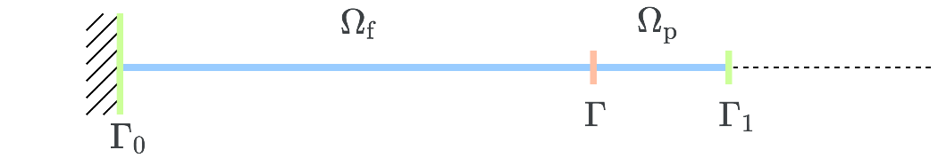
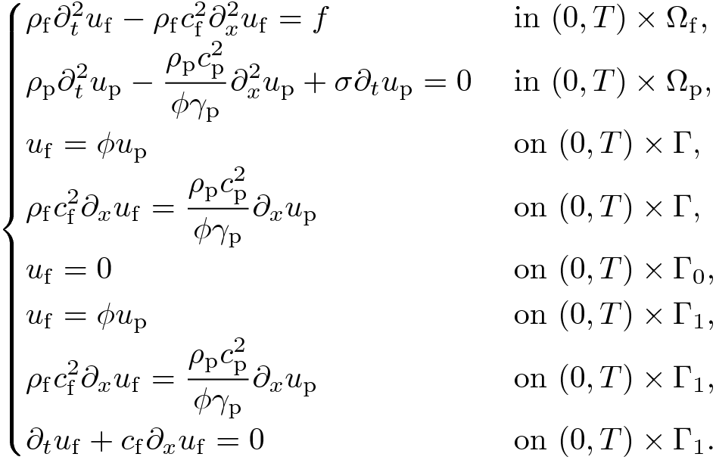
Differential Formulation Fluid – Rigid Porous Coupled Model
Interior domain
Coupling boundary
Exterior boundaries
Notes:
(03:30 – 04:00)
Fluido – poroso con condiciones de contorno rigida – transparente
1 ecuacion para cada medio del dominio:
Eq. Ondas (fluido)
Eq. ondas modificada con resistividad al flujo (poroso)
1 interfaz acoplada (cont. desplazamientos/presiones)
1 frontera rigida (izq)
1 frontera transparente acoplada (dcha)
Acople
Condicion transparente de radiación
Cambio de variable para que desplazamiento sea continuo
Combinar las transparentes
Rho Densidad
C Vel sonido
Phi Porosidad
Gamma Razón de calor específico
Sigma Resistividad al flujo

Slide 9
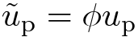
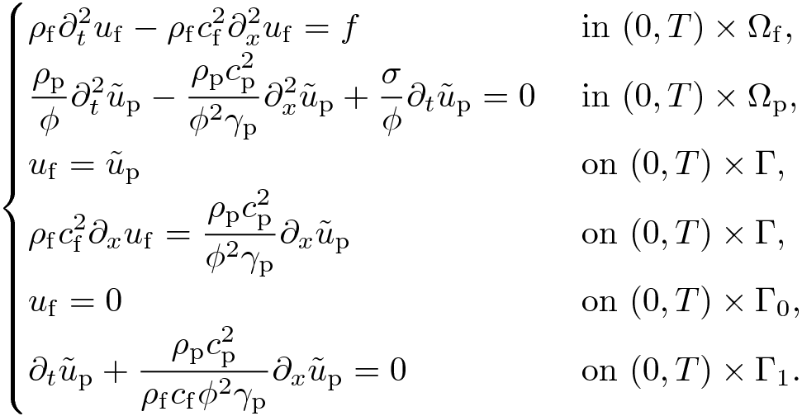
Differential Formulation Fluid – Rigid Porous Coupled Model
Interior domain
Coupling boundary
Exterior boundaries
Notes:
(04:00 – 04:30)
Fluido – poroso con condiciones de contorno rigida – transparente
1 ecuacion para cada medio del dominio:
Eq. Ondas (fluido)
Eq. ondas modificada con resistividad al flujo (poroso)
1 interfaz acoplada (cont. desplazamientos/presiones)
1 frontera rigida (izq)
1 frontera transparente acoplada (dcha)
Acople
Condicion transparente de radiación
Cambio de variable para que desplazamiento sea continuo
Combinar las transparentes
Rho Densidad
C Vel sonido
Phi Porosidad
Gamma Razón de calor específico
Sigma Resistividad al flujo

Slide 10
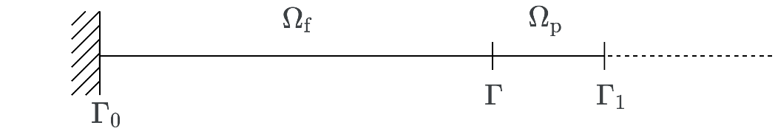
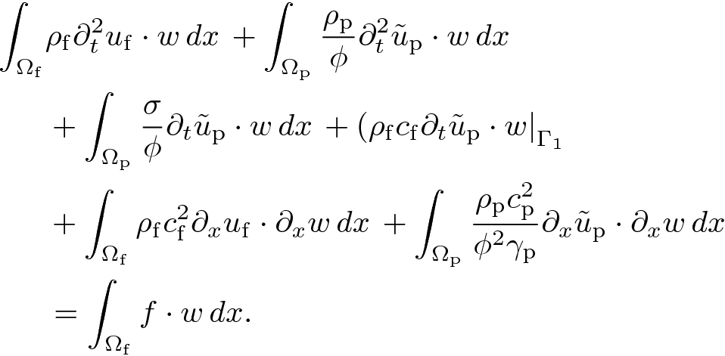
Variational Formulation Fluid – Rigid Porous Coupled Model
Mass term
Damping term
Stiffness term
External forces
Notes:
(04:30 – 05:00)
Terminos de
Masa: segundas derivadas tiempo
Amortiguación: primeras derivadas tiempo
Rigidez: sin derivadas temporalis
Fuerzas externas: sin desplazamientos
Pasos tipicos:
Multiplicar por función test
Integrar en el dominio
Integrar por partes
Aplicar condiciones de contorno
Sumar

Slide 11
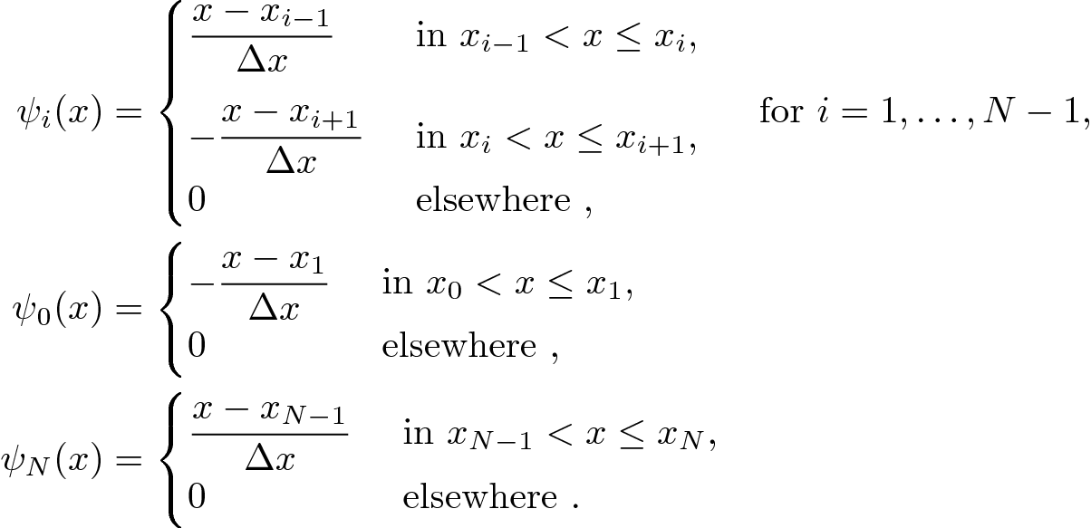
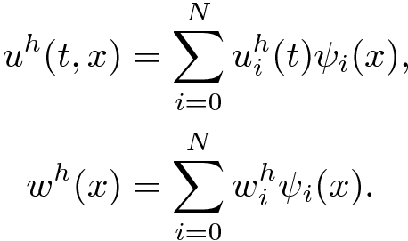
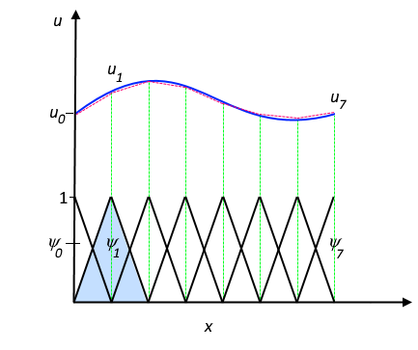
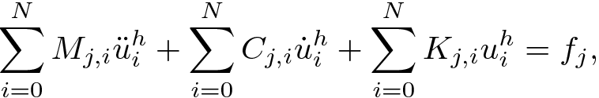
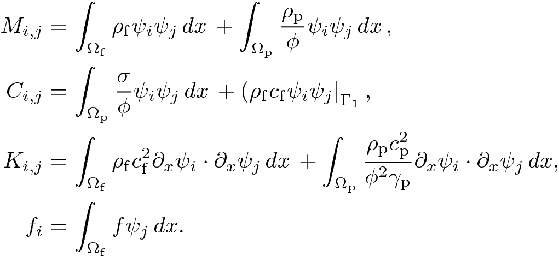
Discretization Algorithms Finite Element Method
Spatial Discretization: Piecewise linear finite element method
Basis functions Discrete solution
Finite Element method discretization
Mass
Damping
Stiffness
External Forces
* Comsol: Multiphysics Cyclopedia: The Finite Element Method (FEM). https://www.comsol.com/multiphysics/finite-element-method
Notes:
(05:00 – 05:30)
Metodo de elementos finitos lineales a trozos
Matrices de masa, amortiguacion, rigidez, fuerzas externas
Ecuacion diferencial ordinaria EDO

Slide 12
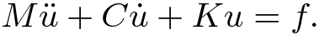
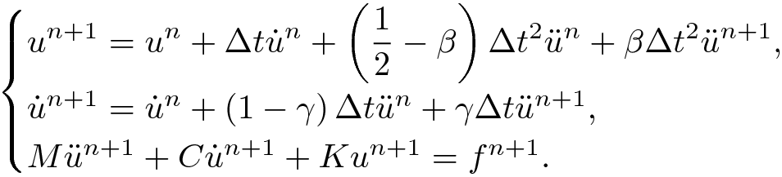
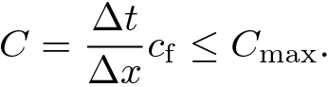
Discretization Algorithms Newmark-Beta Method
Time Discretization: Newmark-beta integration method
In the implementation it is divided in initialization, explicit approximation and prediction.
In order to get accurate results it meets the CFL condition:
Notes:
(05:30 – 06:30)
Ecuacion diferencial ordinaria EDO
En la implementacion:
Inicializacion: Condiciones iniciales y se estima la aceleración
Prediccion explicita de desplazamiento y velocidad
Correccion: Predice (implicita) siguiente paso
Condicion CFL (Courant-Friedrich-Lewy). Velocidad de malla
Muy usado en Acustica
De Segundo orden
Toma la estructura anterior

Slide 13
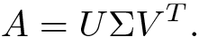
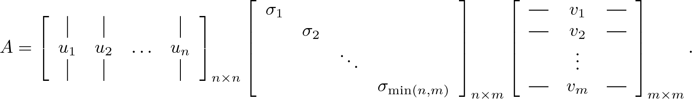
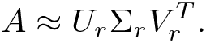
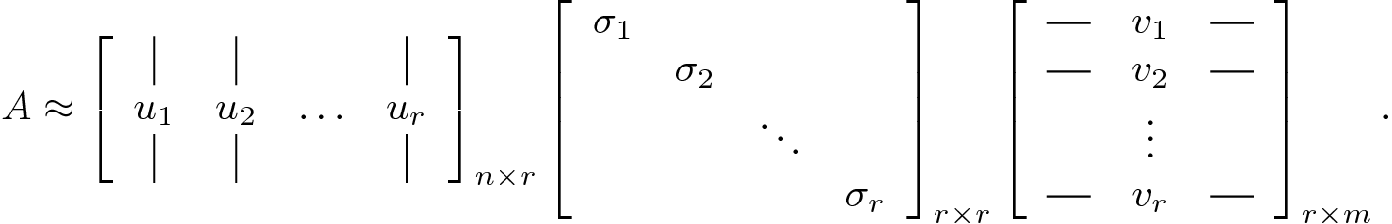
Reduced Order Methods Singular Value Decomposition
Singular Value Decomposition (SVD): Exact decomposition
Truncated SVD: Approximated decomposition
Singular left vectors
Singular values
Singular right vectors
Singular left vectors
Singular values
Singular right vectors
Notes:
(06:30 – 07:30)
SVD No tienen por que ser cuadradas
Descomposicion exacta
T-SVD SVD truncado
Descomposicion aproximada con rango r
r modos más relevantes de los datos

Slide 14
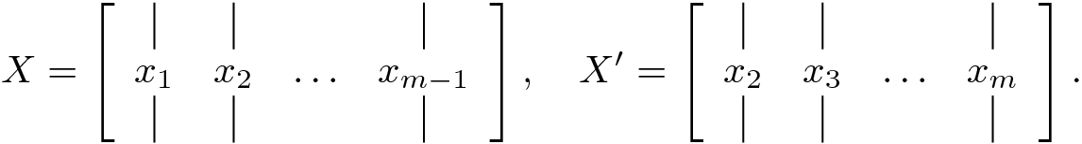
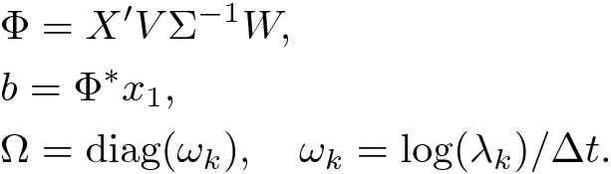
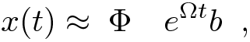
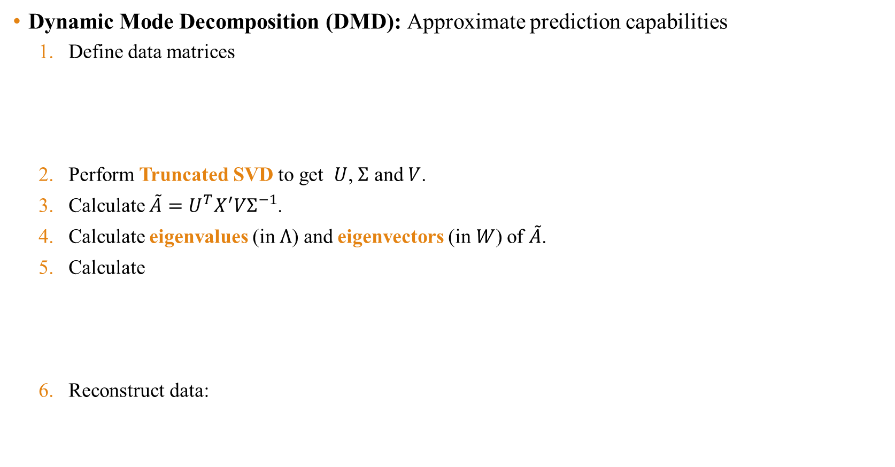
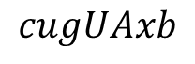
Reduced Order Methods Dynamic Mode Decomposition
Dynamic Mode Decomposition (DMD): Approximate prediction capabilities
Define data matrices
Perform Truncated SVD to get $U$, $Σ$ and $V$.
Calculate $\tilde{A}=U^{T}X^{′}VΣ^{−1}$.
Calculate eigenvalues (in $Λ$) and eigenvectors (in $W$) of $\tilde{A}$.
Calculate
Reconstruct data:
Modes
Initial amplitude
Continuous time eigenvalues
Modes Dynamics
$$cugUAxb$$
Notes:
(07:30 – 08:30)
Utiliza SVD pero añade dinámicas
1. Matrices de datos formadas por instantaneas (snapshots)
3. A tilde: Matriz auxiliar. Mas estable que A (X’SigUTras) (Pseudo inversa de X)
4. Autovalores y autovectores
5. Modos, Amplitudes iniciales y autovalores en tiempo continuo
6. Modos y dinámicas

Slide 15


Software
FEniCS Project: Finite element method
PyDMD: Dynamic mode decomposition
Other Software: ParaView, scikit-learn package, Docker, MATLAB…
Notes:
(08:30 – 09:00)
Fenics: Elementos finitos
Newmark: Python
DMD: pyDMD
Otros: No esencial

Slide 16
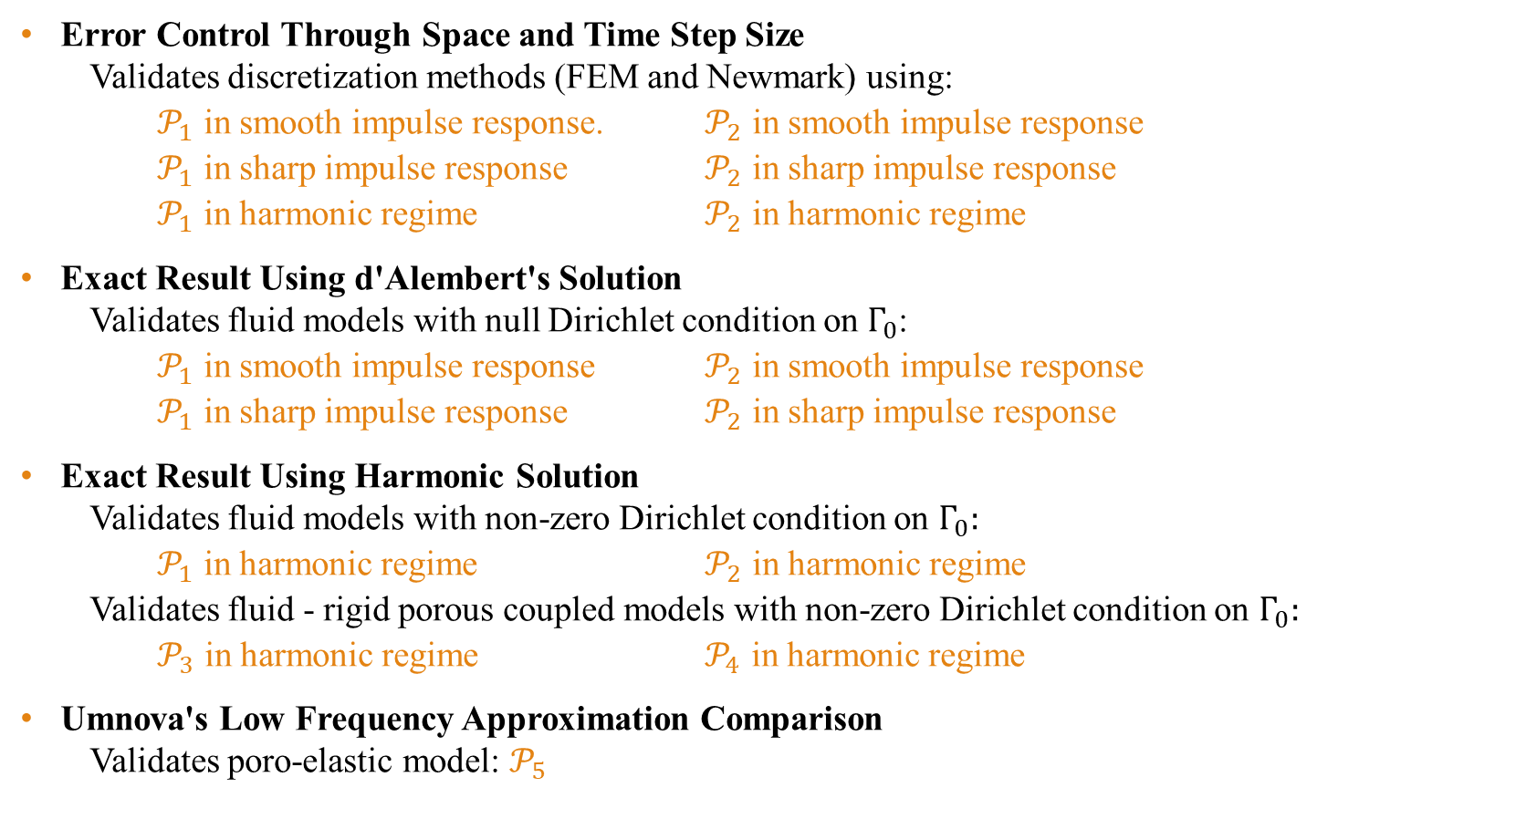
Test Cases
Error Control Through Space and Time Step Size
Validates discretization methods (FEM and Newmark) using:
$𝒫_{1}$ in smooth impulse response. $𝒫_{2}$ in smooth impulse response
$𝒫_{1}$ in sharp impulse response $𝒫_{2}$ in sharp impulse response
$𝒫_{1}$ in harmonic regime $𝒫_{2}$ in harmonic regime
Exact Result Using d'Alembert's Solution
Validates fluid models with null Dirichlet condition on $Γ_{0}$:
$𝒫_{1}$ in smooth impulse response $𝒫_{2}$ in smooth impulse response
$𝒫_{1}$ in sharp impulse response $𝒫_{2}$ in sharp impulse response
Exact Result Using Harmonic Solution
Validates fluid models with non-zero Dirichlet condition on $Γ_{0}:$
$𝒫_{1}$ in harmonic regime $𝒫_{2}$ in harmonic regime
Validates fluid - rigid porous coupled models with non-zero Dirichlet condition on $Γ_{0}:$
$𝒫_{3}$ in harmonic regime $𝒫_{4}$ in harmonic regime
Umnova's Low Frequency Approximation Comparison
Validates poro-elastic model: $𝒫_{5}$
Notes:
(09:00 – 09:15)
Casos test para la validación
1. Métodos de discretización
2. Modelos fluidos con condicion de contorno dirichlet nula en la izq.
3. Modelos con condicion de contorno dirichlet no nula en la izq. Fluido y acoplados poroso rigido
4. Poro-elastico

Slide 17
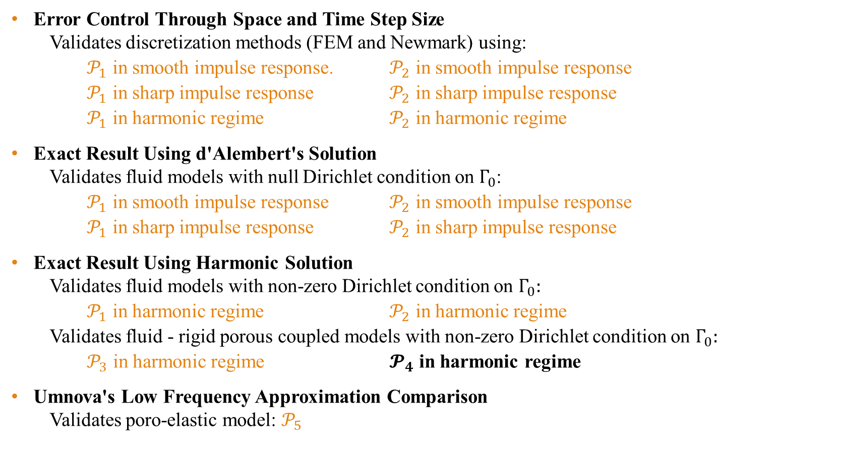
Test Cases
Error Control Through Space and Time Step Size
Validates discretization methods (FEM and Newmark) using:
$𝒫_{1}$ in smooth impulse response. $𝒫_{2}$ in smooth impulse response
$𝒫_{1}$ in sharp impulse response $𝒫_{2}$ in sharp impulse response
$𝒫_{1}$ in harmonic regime $𝒫_{2}$ in harmonic regime
Exact Result Using d'Alembert's Solution
Validates fluid models with null Dirichlet condition on $Γ_{0}$:
$𝒫_{1}$ in smooth impulse response $𝒫_{2}$ in smooth impulse response
$𝒫_{1}$ in sharp impulse response $𝒫_{2}$ in sharp impulse response
Exact Result Using Harmonic Solution
Validates fluid models with non-zero Dirichlet condition on $Γ_{0}:$
$𝒫_{1}$ in harmonic regime $𝒫_{2}$ in harmonic regime
Validates fluid - rigid porous coupled models with non-zero Dirichlet condition on $Γ_{0}:$
$𝒫_{3}$ in harmonic regime $𝓟_{4}$ in harmonic regime
Umnova's Low Frequency Approximation Comparison
Validates poro-elastic model: $𝒫_{5}$
Notes:
(09:15 – 09:30)
Casos test para la validación
1. Métodos de discretización
2. Modelos fluidos con condicion de contorno dirichlet nula en la izq.
3. Modelos con condicion de contorno dirichlet no nula en la izq. Fluido y acoplados poroso rigido
4. Poro-elastico

Slide 18
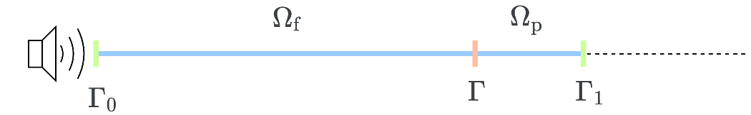
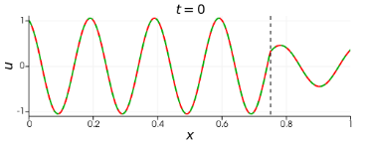
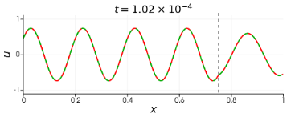
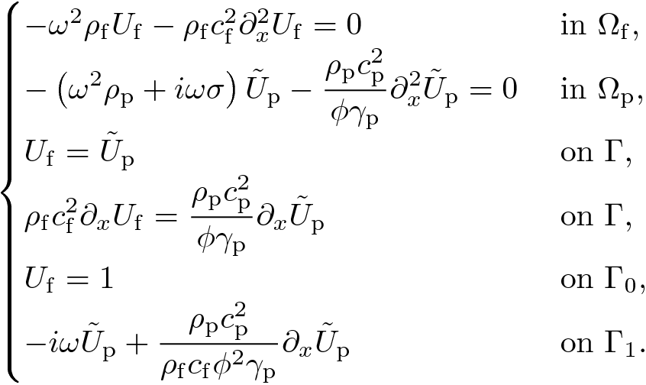
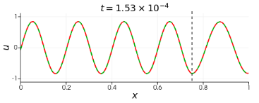
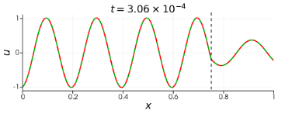
Harmonic Solution
Transform the time domain equations to the frequency domain.
Solve the Helmholtz problem.
Transform back the exact solution to the time domain.
Find the initial conditions for the simulation.
Fluid – rigid porous coupled model with rigid-transparent boundaries.
Notes:
(09:30 – 10:00)
1. Dominio del tiempo -> frecuencia
2. Helmholtz
3. freq. -> tiempo
4. Condiciones iniciales
Figura

Slide 19
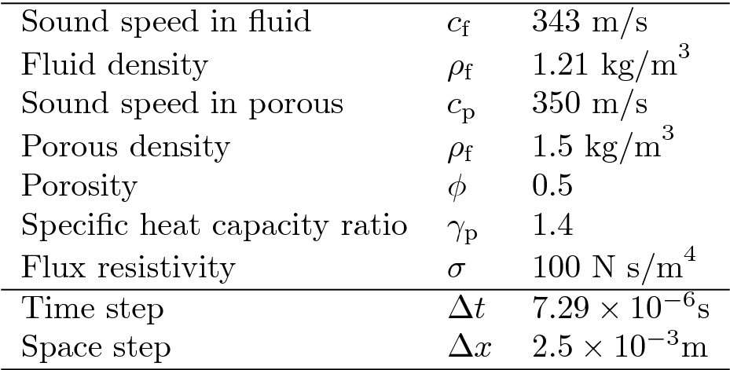
Harmonic Solution
Transform the time domain equations to the frequency domain.
Solve the Helmholtz problem.
Transform back the exact solution to the time domain.
Find the initial conditions for the simulation.
Fluid – rigid porous coupled model with rigid-transparent boundaries.
Notes:
(10:00 – 10:30)
1. Dominio del tiempo -> frecuencia
2. Helmholtz
3. freq. -> tiempo
4. Condiciones iniciales
Figura

Slide 20
Numerical Results
Harmonic Waves
Reconstruction and prediction of harmonic waves.
Test: Reducing the number of snapshots.
Test: Increasing the discretization size.
Periodic Impulse Responses
Reconstruction and prediction of periodic impulse responses.
Test: Reducing the number of snapshots.
Test: Reducing the DMD rank.
Non-Periodic Impulse Responses
Reconstruction and prediction of non-periodic impulse responses.
Other Approaches
Test: DMD vs. HODMD.
Test: DMD vs. SVD.
Simulation mixing.
Shifted DMD.
Notes:
(10:30 – 10:45)
Escenarios
1. Ondas harmonicas
2. Respuestas a impulsos periodicos
3. Respuestas a impulsos no periodicos
4. Otras estrategias

Slide 21
Numerical Results
Harmonic Waves
Reconstruction and prediction of harmonic waves.
Test: Reducing the number of snapshots.
Test: Increasing the discretization size.
Periodic Impulse Responses
Reconstruction and prediction of periodic impulse responses.
Test: Reducing the number of snapshots.
Test: Reducing the DMD rank.
Non-Periodic Impulse Responses
Reconstruction and prediction of non-periodic impulse responses.
Other Approaches
Test: DMD vs. HODMD.
Test: DMD vs. SVD.
Simulation mixing.
Shifted DMD.
Notes:
(10:45 – 11:00)
Escenarios
1. Ondas harmonicas
2. Respuestas a impulsos periodicos
3. Respuestas a impulsos no periodicos
4. Otras estrategias

Slide 22
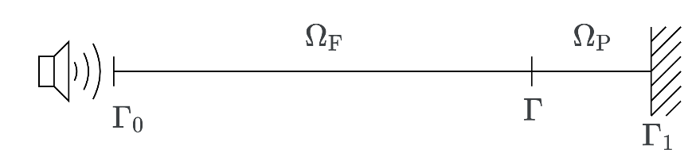
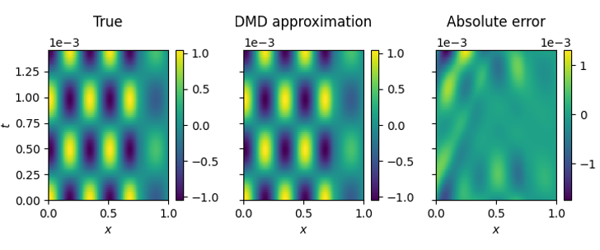
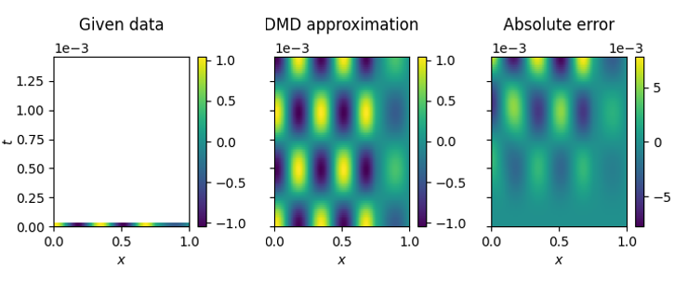
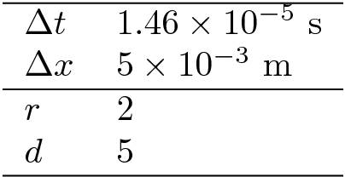
Harmonic Waves
Reconstruction
Prediction
Notes:
(11:00 – 12:00)
Izq: Datos proporcionados, Centro: reconstruccion/prediccion, Dcha: Error absoluto
Error mejora con soluciones exactas o mallas finas
- Numero de instantaneas (snapshots)
- Resolucion de la discretizacion

Slide 23
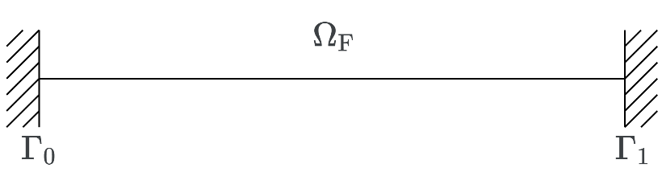
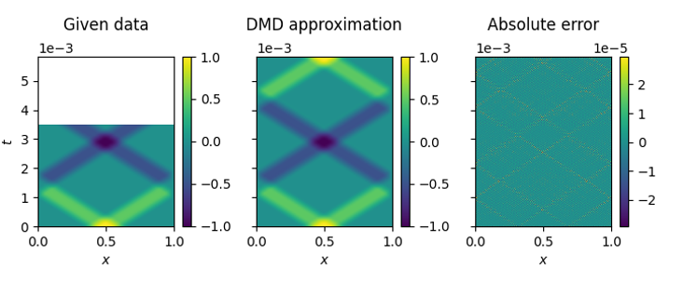
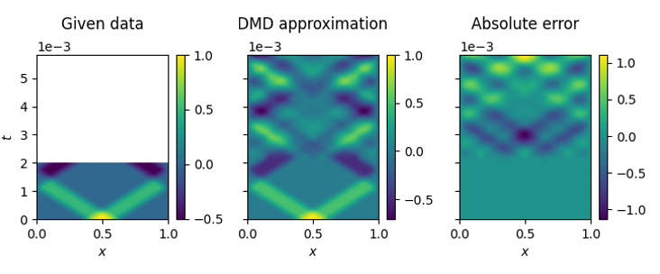
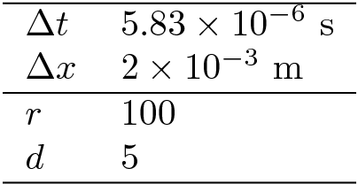
Periodic Impulses
Over a period
Under a period
Notes:
(12:00 – 13:00)
Por encima/debajo de un ciclo de onda (periodo)
Mayor rango baja el error. Infinitos modos (tantos como elementos, discretización)
- Rango DMD

Slide 24
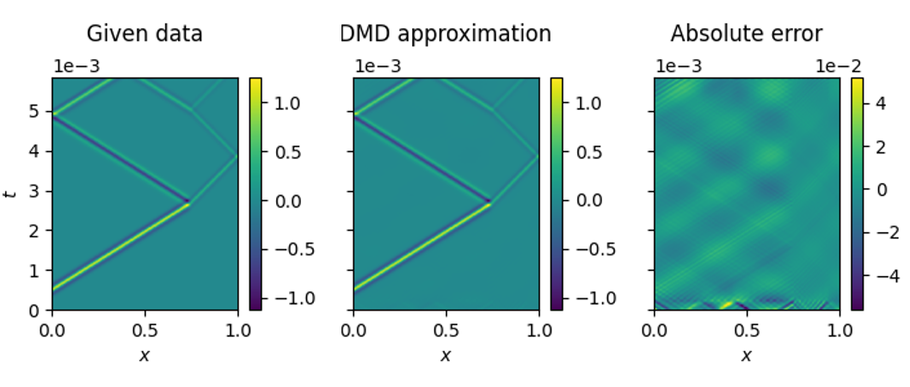


Non-Periodic Impulses
Reconstruction
Prediction
Notes:
(13:00 – 14:00)
No es capaz de hacer predicciones
DMD es un metodo periodico

Slide 25


Other approaches
Simulation Mixing
Shifted DMD
Notes:
(14:00 – 15:00)
Mezcla de simulaciones:
Variación pequeña de un parametron (velocidad del sonido)
Shifted DMD (transformado):
Alinear las trayectorias de los frentes en el eje temporal

Slide 26
Summary
Work completed:
6 Acoustic models
15 Test cases
11 ROMs scenarios
Conclusions:
Accurate results in harmonic cases: only 3 snapshots needed.
Accurate results in periodic impulse response cases: a single wave cycle needed.
Unfeasible use in non-periodic impulse response cases: unable to make predictions.
Unfeasible use using simulation mixing.
Other conclusions (not included in the slides):
Discretization size can affect results.
Increased DMD rank improves predictions.
HODMD is more versatile but requires tuning.
Notes:
(15:00 – 17:00)
6 Modelos, 15 casos de validación, 11 Escenarios de metodos de orden reducido con DMD
Buenos resultados:
- Caso armonico
- Impulsos periodicos (bajo ciertas condiciones)
Malos resultados:
- Impulsos no periodicos
- Mezcla de simulaciones
Otros
- Discretizacion. Malla gruesa dar problemas
- Incrementar rango DMD
- Version de alto orden HODMD es mas versatile pero require configuracion

Slide 27


Next Steps
Explore predictions using MrDMD.
Extend to 3D models.
Explore Shifted DMD for non-periodic impulse responses.
Develop poro-elastic high frequency models.
MrDMD*
Shifted POD**
* https://mathlab.github.io/PyDMD/build/html/tutorial3mrdmd.html ** Reiss, J. et al.: http://dx.doi.org/10.1137/17M1140571.
Notes:
(17:00 – 18:00)
Multi resolution (MrDMD)
1D -> 3D
DMD transformado,
Poroelastico de alta freq. -> Convoluciones

Slide 28
Thank you
Notes:
(18:00 - )
Preguntas

Slide 29



Differential Formulation Umnova’s Porous Low Frequency Approx.
From Umnova et al. 2008, we have the dynamics in pressures and velocities
Transform into a displacements formulation
Find transparent condition through a Taylor approximation of first order, based on the harmonic Sommerfeld condition

Slide 30

Variational Formulation Umnova’s Porous Low Frequency Approx.
Mass term
Damping term
Stiffness term
External forces

Slide 31



Umnova 2008 Comparison
Extract data from Umnova 2008
Compare to simulation’s results
Mexican hat ($ω=50$)
Umnova's Low Frequency Approximation on Porous Media

Slide 32


Method’s Order
Does not meet CFL Condition
Meets CFL Condition

Slide 33






d’Alembert’s Solution
Used in passive fluid models: no speaker perturbation
Choose initial conditions ($u_{f}\left(x,0\right), ∂u_{f}\left(x,0\right)$).
Calculate d’Alembert’s solution.
Fluid model with rigid boundaries.

Slide 34



Used Models
Fluid Models:
$𝒫_{1}$: Fluid model with rigid boundaries
$𝒫_{2}$: Fluid model with rigid-transparent boundaries
Rigid Porous Models:
$𝒫_{3}$: Fluid-Porous Coupled Model with Rigid Boundaries
$𝒫_{4}$: Fluid-Porous Coupled Model with Rigid-Transparent Boundaries
Poro-Elastic Models:
$𝒫_{5}$: Umnova's Low Frequency Approximation on Porous Media
$𝒫_{6}$: Umnova's Low Frequency Approximation on Fluid-Porous Coupled Media

Slide 35



Used Models
Fluid Models:
$𝒫_{1}$: Fluid model with rigid boundaries
$𝒫_{2}$: Fluid model with rigid-transparent boundaries
Rigid Porous Models:
$𝒫_{3}$: Fluid-Porous Coupled Model with Rigid Boundaries
$𝒫_{4}$: Fluid-Porous Coupled Model with Rigid-Transparent Boundaries
Poro-Elastic Models:
$𝒫_{5}$: Umnova's Low Frequency Approximation on Porous Media
$𝒫_{6}$: Umnova's Low Frequency Approximation on Fluid-Porous Coupled Media

Slide 36

Test Cases
Error Control Through Space and Time Step Size
Validates discretization methods (FEM and Newmark) using $𝒫_{1}$ in harmonic regime.
Exact Result Using d'Alembert's Solution
Validates fluid model with rigid boundaries: $𝒫_{1}$ with null Dirichlet condition on $Γ_{0}$.
Validates fluid model with rigid-transparent boundary: $𝒫_{2}$ with null Dirichlet condition on $Γ_{0}$.
Exact Result Using Harmonic Solution
Validates fluid model with rigid boundaries: $𝒫_{1}$ with non-zero Dirichlet condition on $Γ_{0}$.
Validates fluid model with rigid-transparent boundaries: $𝒫_{2}$ with non-zero Dirichlet condition on $Γ_{0}$.
Validates fluid - rigid porous coupled model with rigid boundaries: $𝒫_{3}$ and $𝒫_{4}$.
Validates fluid - rigid porous coupled model with rigid-transparent boundaries: $𝒫_{4}$.
Umnova's Low Frequency Approximation Comparison
Validates poro-elastic model: $𝒫_{5}$.

Slide 37

Test Cases
Error Control Through Space and Time Step Size
Validates discretization methods (FEM and Newmark) using $𝒫_{1}$ in harmonic regime.
Exact Result Using d'Alembert's Solution
Validates fluid model with rigid boundaries: $𝒫_{1}$ with null Dirichlet condition on $Γ_{0}$.
Validates fluid model with rigid-transparent boundary: $𝒫_{2}$ with null Dirichlet condition on $Γ_{0}$.
Exact Result Using Harmonic Solution
Validates fluid model with rigid boundaries: $𝒫_{1}$ with non-zero Dirichlet condition on $Γ_{0}$.
Validates fluid model with rigid-transparent boundaries: $𝒫_{2}$ with non-zero Dirichlet condition on $Γ_{0}$.
Validates fluid - rigid porous coupled model with rigid boundaries: $𝒫_{3}$.
Validates fluid - rigid porous coupled model with rigid-transparent boundaries: $𝓟_{4}$.
Umnova's Low Frequency Approximation Comparison
Validates poro-elastic model: $𝓟_{5}$.

Slide 38

Differential Formulation Fluid – Rigid Porous Coupled Model
Interior domain
Coupling boundary
Exterior boundaries
Notes:
(04:00 – 04:30)
Fluido – poroso con condiciones de contorno rigida – transparente
1 ecuacion para cada medio del dominio
1 interfaz acoplada
1 frontera rigida (izq)
1 frontera transparente acoplada (dcha)
Combinar las transparentes
Definir u tilde sub p (utp)

